Slide 1

DEPARTMENT OF COMPUTER SCIENCE AND ENGINEERING
Project name : Traffic Management
Team name : Proj_224783_Team_3
Team members :
VIGNESH B(113321104114)
VIKRAM RAJ V P(113321104115)
VISHVAKUMAR L(113321104116)
YANDODU VIVEK REDDY(113321104118)

Slide 2
OBJECTIVE:
1. Alleviating Congestion: One of the foremost goals is to alleviate traffic congestion within urban areas. This may entail the implementation of strategies like intelligent traffic signal control, effective lane management, and the introduction of congestion pricing.
2. Improving Safety: Prioritizing road safety is of paramount importance. Projects strive to reduce accidents and fatalities through initiatives like enhanced road design, improved signage, and the deployment of traffic-calming measures.
3. Enhancing Traffic Efficiency: The project may also focus on optimizing traffic flow by utilizing real-time data and adaptive traffic signal systems. This optimization can lead to reduced travel times and decreased fuel consumption.
4. Promoting Sustainable Transportation: Encouraging the utilization of sustainable modes of transportation such as public transit, cycling, and walking is essential. This not only reduces the number of vehicles on the road but also minimizes the environmental impact.
5. Mitigating Emissions: Implementing measures to curtail vehicle emissions is a significant aspect of the project. This can involve the promotion of electric vehicles, fostering carpooling, and optimizing traffic management to diminish idle times.

Slide 3
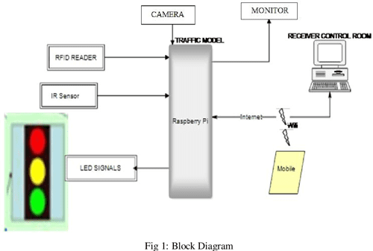
IOT SETUP:

Slide 4
Step 1: Sensor Selection
1. Traffic Cameras: Traffic cameras capture real-time images or video footage of road conditions, offering insights into aspects such as traffic flow, congestion, and accident occurrences. They are instrumental in providing visual monitoring of the road network.
2. Inductive Loop Sensors: Embedded within the road surface, inductive loop sensors detect the presence of vehicles by measuring changes in inductance. Typically deployed at intersections, these sensors help monitor traffic volume and facilitate the efficient control of traffic signals.
3. Acoustic Sensors: Acoustic sensors utilize sound waves to detect vehicle movement and congestion. They can be strategically positioned on lampposts or bridges, allowing for non-contact monitoring of traffic conditions.
4. Radar Sensors: Radar sensors operate by emitting radio waves to ascertain the speed and distance of vehicles. They prove invaluable in monitoring traffic speed and identifying congestion hotspots.
5. GPS and Mobile Apps: Many vehicles are equipped with GPS devices or rely on mobile apps equipped with location services. The data collected from these sources offers valuable insights into traffic patterns and vehicle speeds, aiding in traffic management and navigation.

Slide 5
Step 2: Data Collection
Once the sensor selection is complete, the next step is to establish a method for data collection. This generally entails the deployment of an Internet of Things (IoT) device network for transmitting data to a central data hub. Here's how data is typically collected from various sensors:
1. Traffic Cameras: Traffic cameras send real-time images or video feeds to a central server for storage and analysis.
2. Inductive Loop Sensors and Acoustic Sensors: These sensors transmit data wirelessly to a central receiver, where the information is collected and processed.
3. Radar Sensors and GPS Devices: Radar sensors and GPS devices come equipped with their own data transmission capabilities, ensuring that their data is directly accessible for analysis and integration into the traffic management system.

Slide 6
Step 3: Data Processing
With the data collection phase in place, we turn this raw data into valuable insights through the power of machine learning algorithms and data analytics. Here's how we process and extract meaningful information from the collected data:
1. Traffic Camera Images: By leveraging machine learning algorithms and data analytics, we can analyze traffic camera images to identify congestion, accidents, and traffic patterns, enabling us to take proactive measures in managing traffic flow and safety.
2. Inductive Loop Sensor Data: The data from inductive loop sensors is processed to monitor traffic volume and fine-tune traffic signal timings. Machine learning and data analytics assist in optimizing traffic flow at intersections based on real-time traffic conditions.
3. Acoustic Sensor Data: Acoustic sensor data is analyzed to detect honking and unusual sounds associated with accidents, offering valuable insights for quick response and accident management.
4. Radar Data: Radar data is processed to calculate vehicle speed and density, aiding in the identification of traffic speed violations and congestion hotspots.
5. GPS and Mobile App Data: Data from GPS devices and mobile apps are harnessed to provide real-time information on vehicle locations and speeds, allowing for dynamic traffic monitoring and navigation assistance. Machine learning algorithms can also be used to predict traffic patterns based on historical data.
In this way, through the application of advanced technology and analytics, we transform raw data into actionable insights for more efficient traffic management and safer road conditions.

Slide 7
Step 4: Visualization and Control
In order to make the collected data understandable and actionable, the use of user-friendly interfaces is essential. These interfaces can take the form of traffic management dashboards, mobile applications, and even electronic road signs. These tools play a crucial role in facilitating communication and decision-making for traffic managers as well as providing real-time information to drivers.

Slide 8
Raspberry Pi integration:
Step 1: Understand Raspberry Pi's role in traffic management.
Step 2: Integrate sensors (like cameras or inductive loop sensors) with Raspberry Pi.
Step 3: Raspberry Pi collects and stores data from the connected sensors.
Step 4: Process data using programming (e.g., Python) to gain insights.
Step 5: Ensure data safety by connecting Raspberry Pi to external storage solutions (e.g., hard drives or cloud storage).

Slide 9
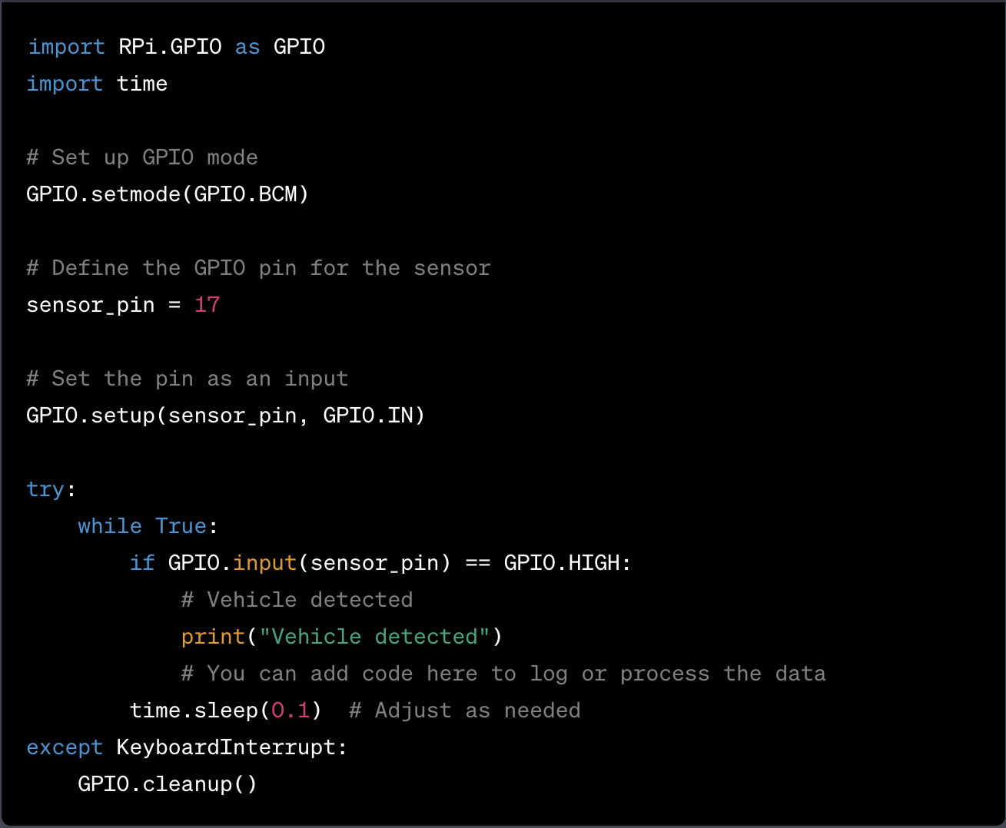
EXAMPLE CODE IMPLEMENTATION:
Let's assume you have an inductive loop sensor that provides a signal when a vehicle passes over it. You can connect the sensor to a GPIO pin on the Raspberry Pi and use Python to capture the data.

Slide 10
In this example, the Raspberry Pi waits for a signal from the inductive loop sensor connected to GPIO pin 17. When a vehicle is detected, it prints a message. You can replace the print statement with code to log or process the data as required.

Slide 11
THANK YOU

